Slide 1
Combining a Pre-Test and Post-Test to Create a SCORM-Compliant Assessment:
Multiple Learning Objectives per Topic

Slide 2
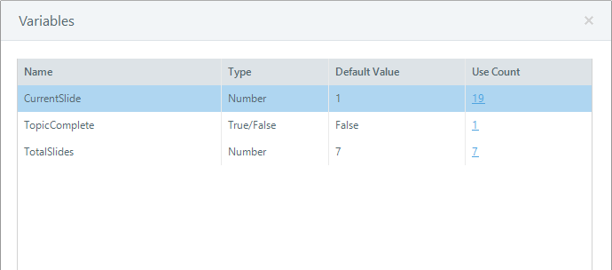
Variables
Text
True/False
Number
Can be set to a string of text, such a word or sentence.
Can be set to either True or False. Your trigger will take one action if set to True, another if set to False.
Can be set to a number. Your trigger can take various actions based on the value of the number.

Slide 3
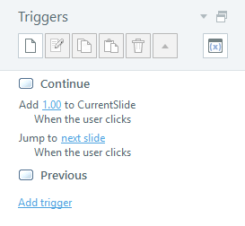
Number Variables
%CurrentSlide% of %TotalSlides%

Slide 4
Number Variables
1 + 1 = 2

Slide 5
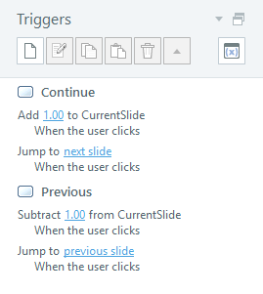
Number Variables
2 + 1 = 3
2 - 1 = 1

Slide 6
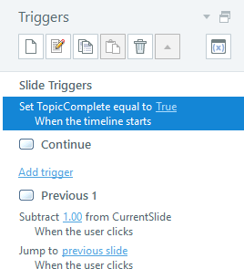
True/False Variables
7 - 1 = 6

Slide 7
Variables
True/False
Number
Can be set to either True or False. Your trigger will take one action if set to True, another if set to False.
Can be set to a number. Your trigger can take various actions based on the value of the number.

Slide 8
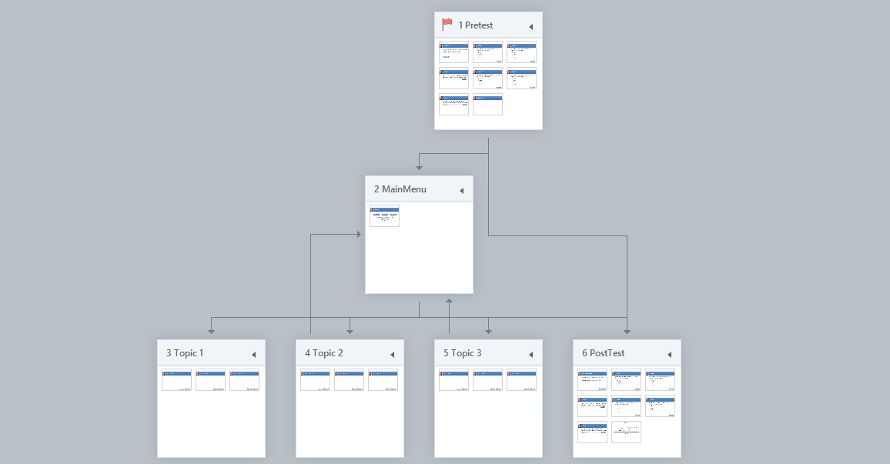
Course Structure

Slide 9
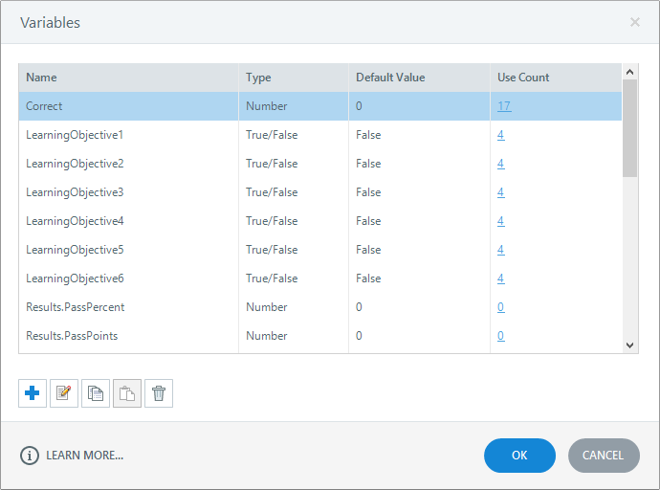
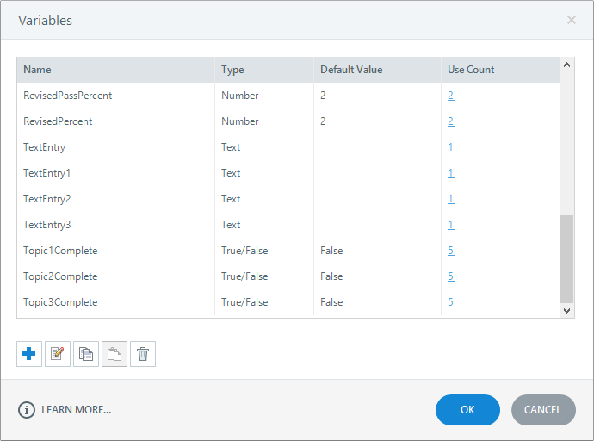
Course Variables

Slide 10
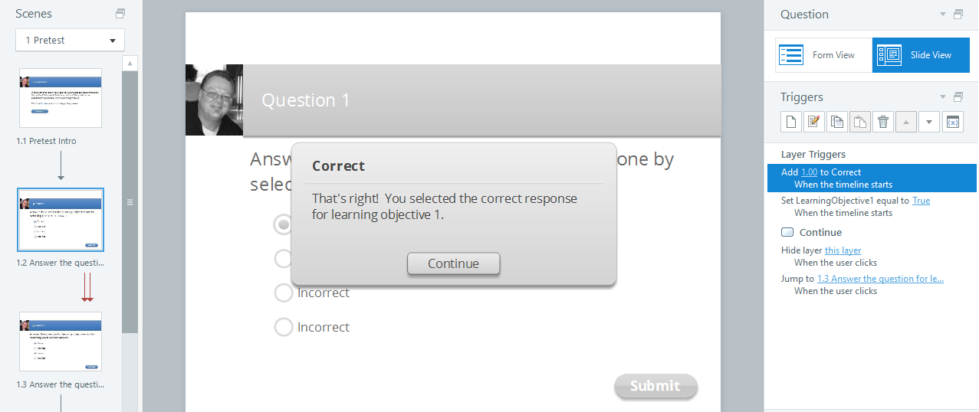
Pre-Test

Slide 11
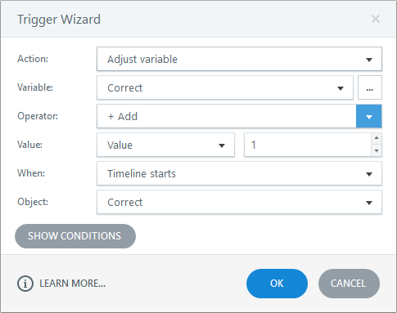
Pre-Test

Slide 12
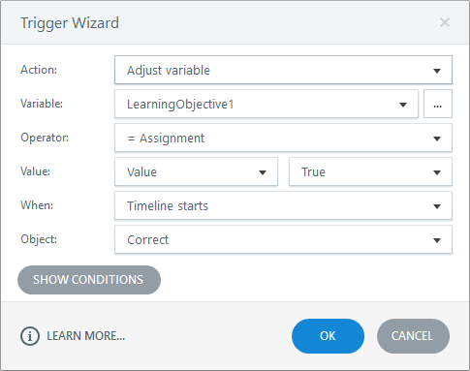
Pre-Test

Slide 13
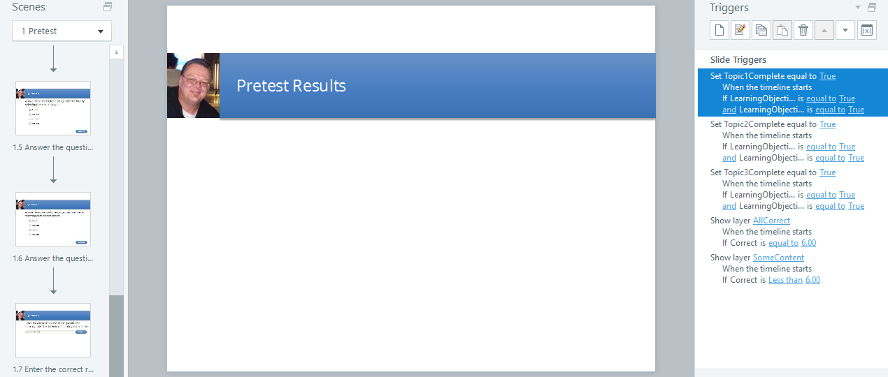
Pre-Test

Slide 14
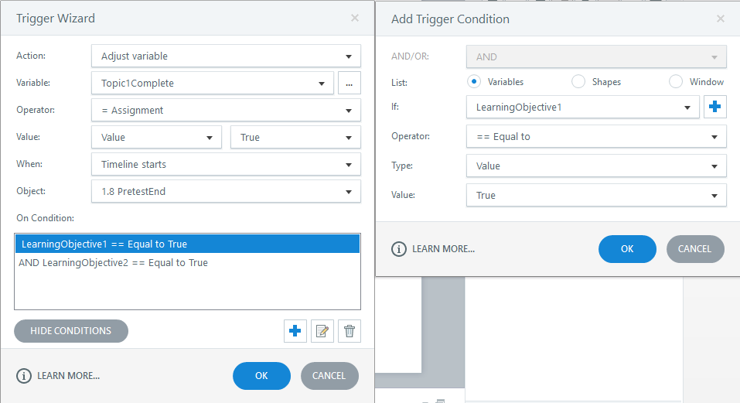
Pre-Test

Slide 15
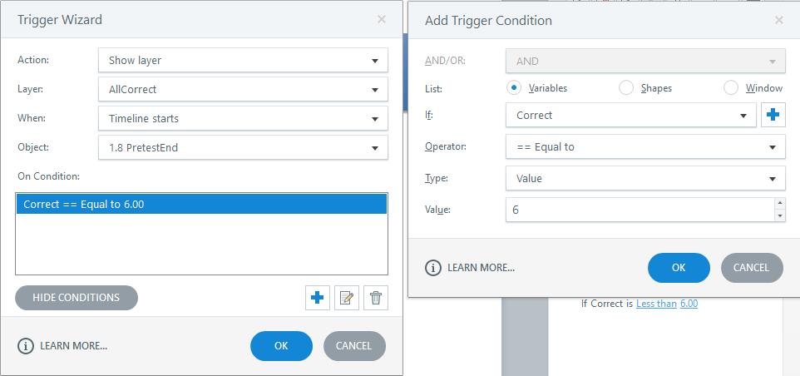
Pre-Test

Slide 16
Main Menu

Slide 17
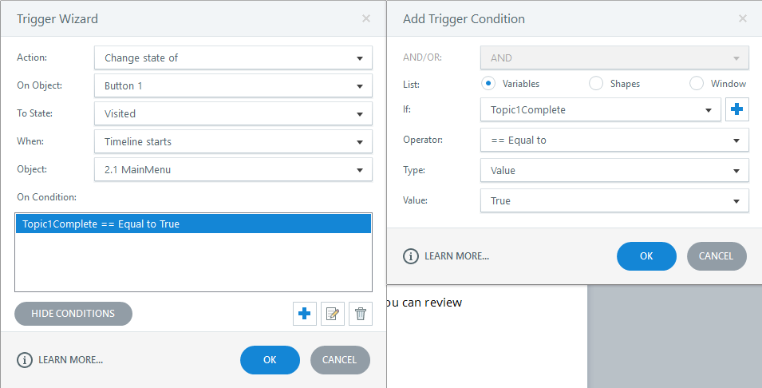
Main Menu

Slide 18
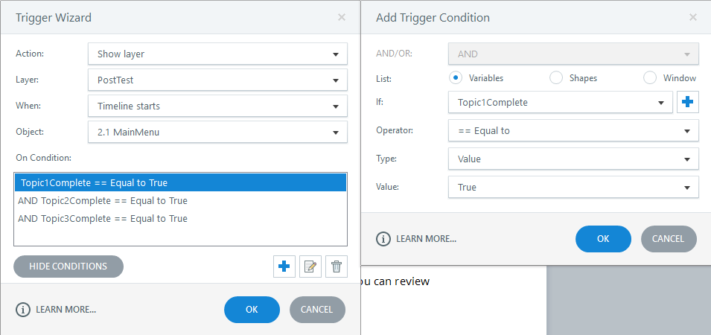
Main Menu

Slide 19
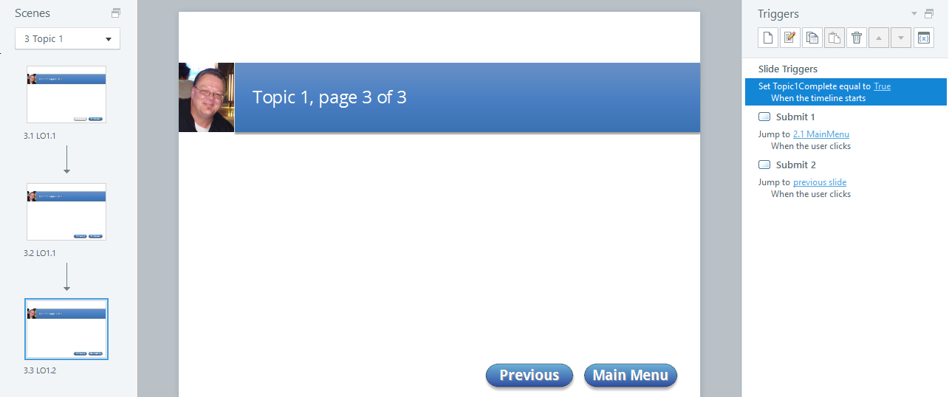
Content Pages

Slide 20
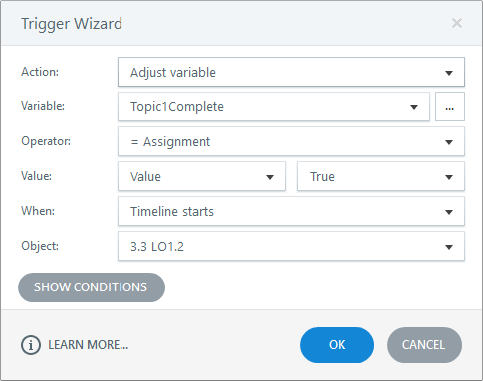
Content Pages

Slide 21
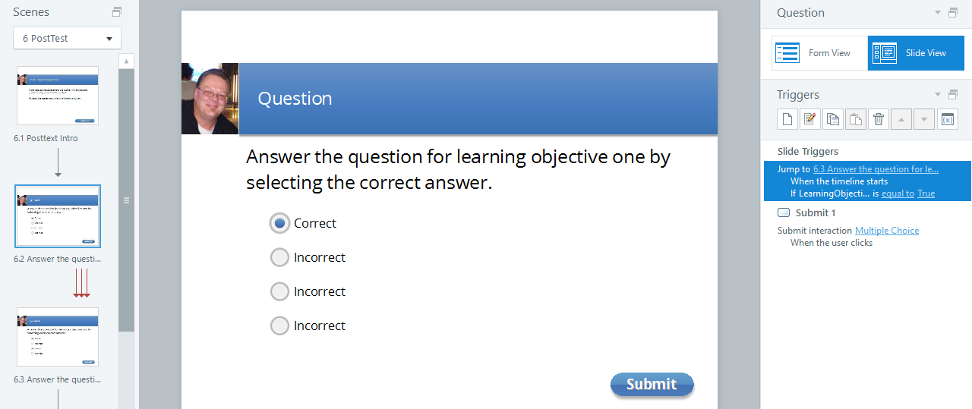
Post-Test

Slide 22
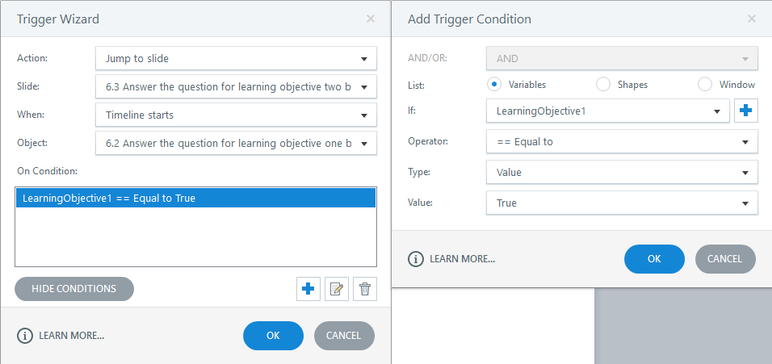
Post-Test

Slide 23
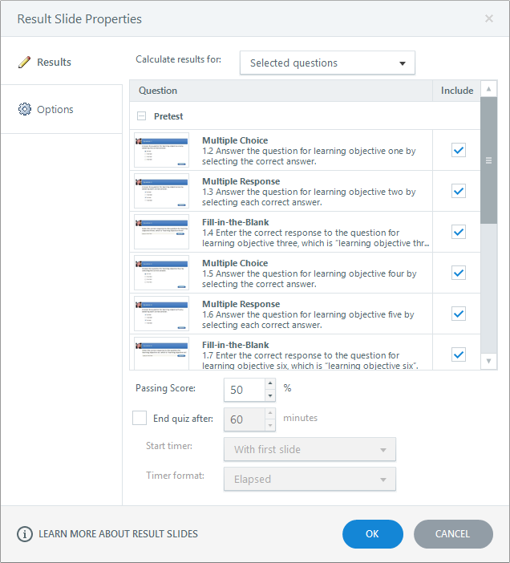
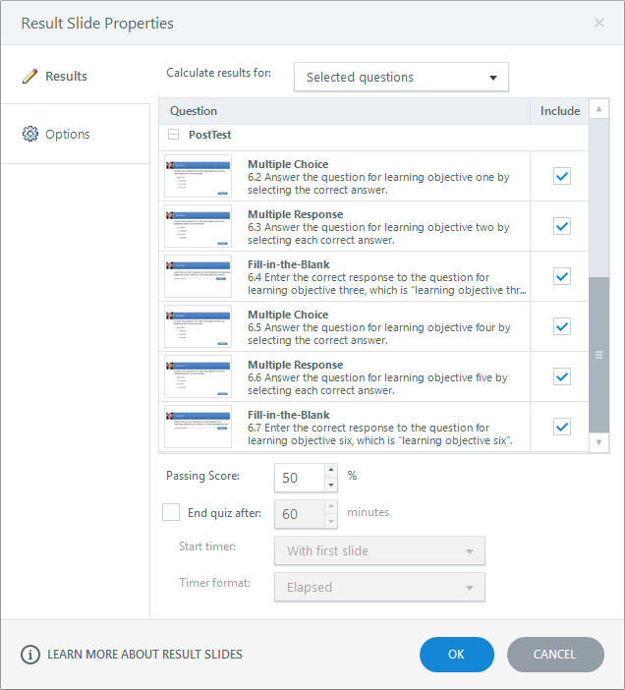
Results Slide

Slide 24
Results Slide

Slide 25
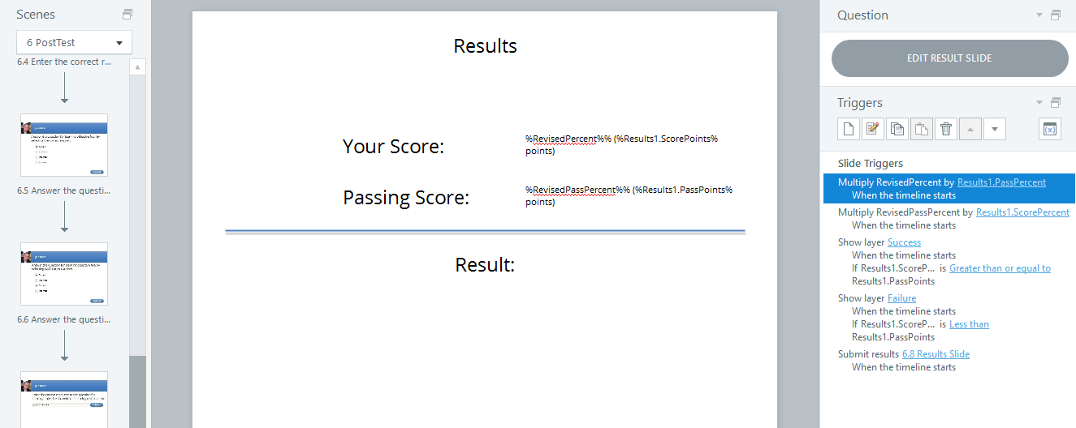
Results Slide

Slide 26
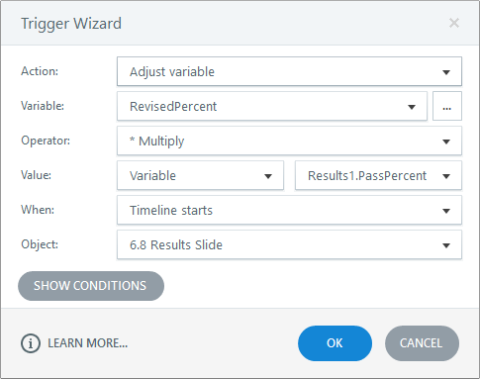
Results Slide

